Slide 1
Progressive
Discipline
A Guide for Food Service Managers

Slide 2
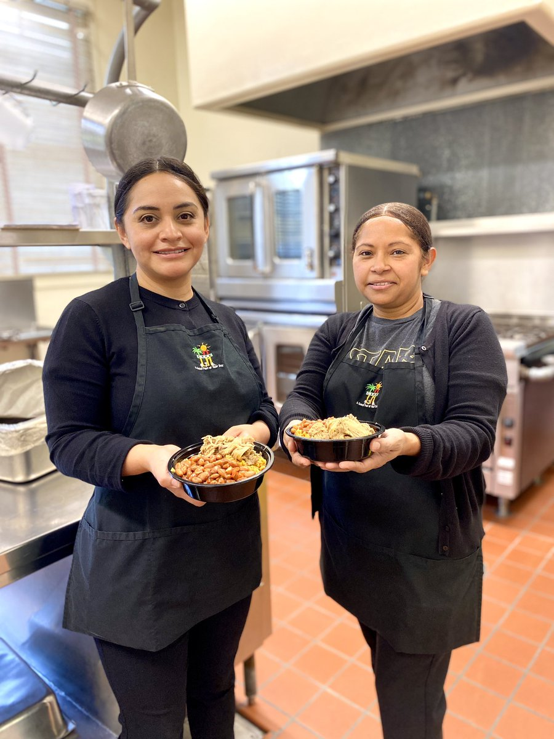
Overview
Progressive discipline is the process to improve employee performance through steps and measures.
This training will discuss:
What is progressive discipline.
Informal counseling and training forms.
Key policies every manager should know.
Composing effective Incident Logs.
H/R Disciplinary Actions Flow Chart.
Notes:
TELL: Progressive discipline is the process to improve employee performance through steps and measures. This training will discuss: What is progressive discipline, key policies every manager should know, composing effective incident logs, and h/r disciplinary actions flow chart.

Slide 3
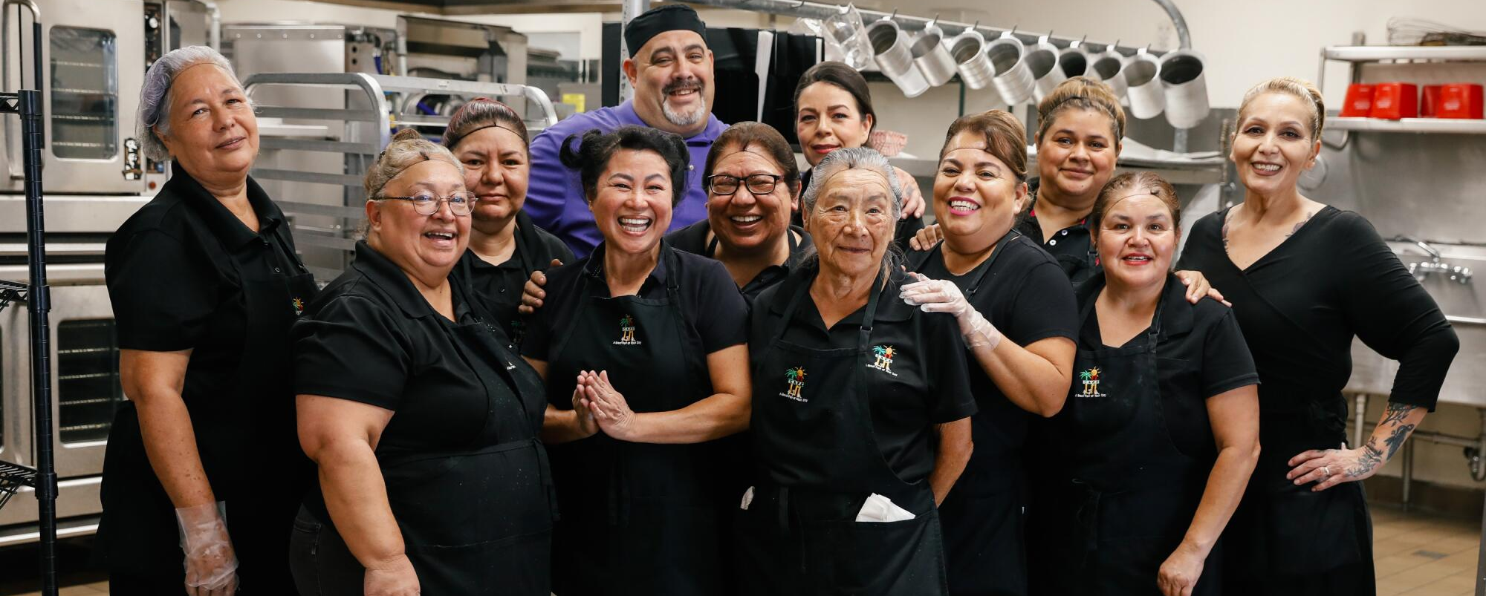
Set Up for Success
Ensure that your staff is equipped with the proper tools and resources to do their job successfully.
Continuous training is key.
Provide frequent feedback and coaching.
Encourage professional development by attending classes offered by Organizational Excellence or Food Services and/or MyPLN.
Notes:
TELL: Ensure that your staff is equipped with the proper tools and resources to do their job successfully. Continuous training is key. Provide frequent feedback and coaching. Encourage professional development by attending classes offered by Organizational Excellence and/or MyPLN.

Slide 4
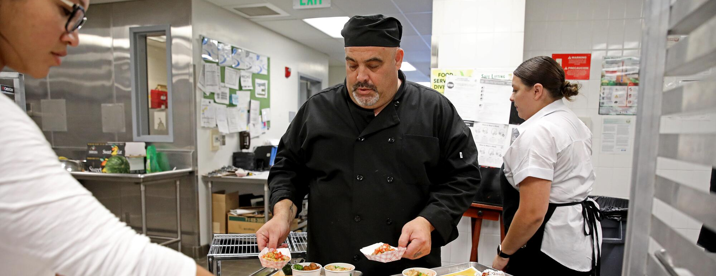
Why Positive Reinforcement
Positive reinforcement encourages the desired behavior and is a better motivator than the threat of disciplinary action.
Recognize positive behaviors by giving praise.
Reward staff for good behavior.
Show appreciation by simply saying “Thank You”.
Notes:
TELL: Positive reinforcement encourages the desired behavior and is a better motivator than the threat of disciplinary action. Recognize positive behaviors by giving praise, reward staff for good behavior, and show appreciation by simply saying “Thank You”.

Slide 5
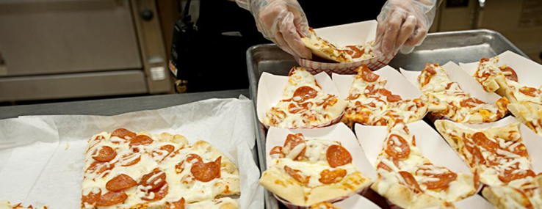
What is Progressive Discipline?
Progressive discipline is the multi-level approach of using steps or measures to modify behavior, before penalizing an employee.
Employees must be informed of standards required.
Attempt to change behavior first before penalty.
Progression starts with verbal warnings and leads to written documentation.
Notes:
TELL: Progressive discipline is the multi-level approach of using steps or measures in an attempt to modify behavior, before penalizing an employee. Employees must be informed of standards required. Attempt to change behavior first, before penalizing. Progression starts with verbal warnings and leads to written documentation.

Slide 6
Setting the Expectations
The first phase of progressive discipline is setting expectations right from the start.
Review the Food Services Division Employee Handbook with every employee.
Review Orientation Checklist with newly hired, promoted, transferred employee.
Notes:
TELL: The first step of progressive discipline is setting expectations right from the start. Review the Food Services Division’s Employee Handbook with every employee. This should be done at the start of every school year. Review orientation checklist with newly hired, promoted, transferred employee. Remember, even if an employee has been with the district for 20 years and is transferred to your location, you must still review the Employee Handbook with all regular employees who are at your school.

Slide 7
Council, Train, & Document
The second phase of progressive discipline is counseling, training, and documentation:
Incident Record - is a training tool used to inform the employee of the correct way to perform the job.
Conference Memo - identifies that the employee knows or should know a process, helps and/or further training, and states consequences if not followed.
Letter of Reprimand – informs employee of behavior/performance that needs immediate correction, offers assistance and training, and states consequences if the actions are repeated.
Notice of Unsatisfactory Service (NOUS) – no action (written warning).
Notes:
TELL: The second phase of progressive discipline is informal counseling, training, and documentation. The first form is an incident log. Please note that it is meaningless to write Incident Log after Incidents Log for the same incident. Provided that the employee has received sufficient counseling and training, a Conference Memo, Letter of Reprimand, or a Notice of Unsatisfactory Service may be required as the next steps of progressive discipline. Additionally, in some cases you may escalate directly to a conference memo or Letter or Reprimand if the behavior warrants it. By addressing these issues or concerns, you will find it easier and more effective to compose and conduct performance evaluations at the end of the school year.

Slide 8
Paddle Activity #1
What is the training tool used to inform the employee of the correct way to perform the job?
Select the correct answer:
Incident Record
Conference Memo
Notes:
TELL: Time for a paddle activity. What is the training tool used to inform the employee of the correct way to perform the job?
Please raise your paddle according to your selection.

Slide 9
Disciplinary Action
The third phase of progressive discipline is taking disciplinary action. Disciplinary Action as defined in Personnel Commission Rule 901 is the:
Suspension: 1-30 calendar days and may be more than one occurrence of suspension.
Demotion to a lower classification.
Dismissal from service.
Note: This affects an employees pay or status and requires Board Action.
Notes:
TELL: The third phase of progressive discipline is taking disciplinary action. Disciplinary Action as defined in Personnel Commission Rule 901 is the: Suspension: 1–30 calendar days and may be more than one occurrence of suspension; Demotion to a lower classification; and Dismissal from service. Note: This affects an employee’s pay or status and requires Board Action.

Slide 10
Attendance Expectations
As stated in the FSD Handbook, Food Service employees must personally contact their Manager on each day of an absence, unless the employee is placed on extended leave.
If an employee is absent more than 5 consecutive days, the District Absence Certification Form (No. 60 ILL,
Rev 09/14/20) must be submitted with a Physician’s statement.
Initial probationary employees are allowed only up to six (6) illness/personal necessity or unpaid days during the 130 – day probationary period.
Notes:
TELL: One of the most common HR concerns found in the District is regarding Attendance. As stated in the Food Services handbook, employees must personally contact their Manager on each day of an absence, unless the employee is placed on an extended leave. If an employee is absent more than 5 consecutive days, a Physician statement is required and must be submitted w/ the District’s Absence Certification Form No 60.ILL,Rev 09/14/20). Initial probationary employees are allowed only up to six (6) illness/personal necessity or unpaid days during the 130-day probationary period.

Slide 11
Reporting Employee Absence
FSM must complete the Absence/Tardy/FMLA Log to report each day of an employee’s absence. Key acronyms to be aware of are:
AWOA: Absence without authorization – more than 5 days.
AWOL: Absence without leave – more than 20 days.
May require verification of an employee’s absence from health care provider when there is a reasonable suspicion of abuse for any claimed illness, injury, disability, or when necessary for health and safety reasons.
Notes:
TELL: Managers must complete the Absence/Tardy/FMLA log to report each day of an employee’s absence. Key Acronyms that Managers should be aware of are AWOA which stands for absence without authorization which applies to absences of more than 5 days. The acronym AWOL stands for absence without leave which applies to absences more than 20 days. May require verification of an employee’s absence from health care provider when there is a reasonable suspicion of abuse for any claimed illness, injury, disability, or when necessary for health & safety reasons.

Slide 12
Paddle Activity #2
Absences for 20 days or more without leave is called?
Select the correct answer:
AWOL
AWOA
Notes:
TELL: Time for a paddle activity. Absences for 20 days or more with out leave is called? Please raise your paddle according to your selection.

Slide 13
Patterns of Excessive Absence
Examples of patterns of excessive absenteeism:
Employee has frequent short-term absences.
Employee consistently & frequently uses his/her benefitted time off.
Absence occurs:
On a Monday or Friday pattern.
Before or after disciplinary action.
After vacation request is denied.
Before or after vacation.
Note: Attendance is a factor in granting Summer Employment.
Notes:
TELL: Managers should observe and take note of patterns of excessive absenteeism. Some examples are: Employees with frequent short term absences, employees consistently & frequently uses his/her benefitted time off, absences that occur on Monday or Friday, before or after disciplinary action, after vacation requests are denied, or before or after vacation. Note, attendance is a factor in granting Summer Employment.

Slide 14
Work Schedules and Breaks
FSM are tasked to ensurethat work schedules are followed and breaks and/or lunches are taken at the appropriate times.
Employees working:
Four (4) hours are entitled to one 10-minute break.
Six (6) hours or more are entitled to one 30-minute duty free (unpaid) lunch period and two 10-minute breaks during their shift.
Note: Two 10-minute breaks may be combined into one (1) 20-minute break but must be approved by the FSM/AFSS.
Notes:
TELL: FS Managers are tasked to ensure that work schedules are followed and breaks and/or lunches are taken at appropriate times. Employees working for: Four (4) hours but less than 6 hours are entitled to one 10 minute break. Six (6) hours or more are entitled to one 30 minute duty free lunch period and two 10 minute breaks during their shift. Note: Two 10 minute breaks may be combined into one 20 minute breaks but must be approved by the FSM/AFSS.

Slide 15
Paddle Activity #3
Fill in the blank:
Employees working for ? hours or more are entitled to one (1) 30-minute duty free lunch period and two (2) 10-minute breaks during their shift.
6 Hours
4 Hours
Notes:
TELL: Time for a paddle activity. Absences for 20 days or more with out leave is called? Please raise your paddle according to your selection.

Slide 16
Workers’ Compensation
FSM have the responsibility to:
Call 911 if the injury is serious and requires emergency medical attention.
Notify AFSS within one hour of serious injuries.
Provide the employee with W/C Claim Form (CA DWC-1) within 24 hours. If the employee does not return within 24 hours, the form must be mailed.
Complete and provide a Medical Authorization Form if employee requires medical treatment.
Notes:
TELL: FS Managers have the responsibility to call 911 if injury is serious & requires emergency medical attention. Notify AFSS within one hour if injury is serious. Provide employee with W/C Claim Form (CA DWC-1) within 24 hours. If employee does not return w/in 24 hours, the form must be mailed. Lastly, complete and provide a Medical Authorization Form if employee requires medical treatment.

Slide 17
Workers’ Compensation Cont.
Additional FSM responsibilities:
Investigate injury ASAP and complete the Injury/Incident Investigation Report (ISTAR).
Immediately provide Claim Withdrawal Form to employee who choose not to seek medical attention.
Report Injury to Sedgwick immediately (within 24 hours) unless only first-aid is required, and the employee fills out the medical waiver claim.
Provide employee re-training if applicable.
Notes:
TELL: Additional FS Manager responsibilities include investigating the injury ASAP & completing the Injury/Incident Investigation Report (ISTAR). During your safety meetings, emphasize to your employees that “all work-related injuries must be reported immediately.” Immediately provide Claim Withdrawal Form to employee who chose not to seek medical attention. Report Injury to Sedgwick immediately (w/in 24 hours) unless only first-aid is required and the employee fills out the medical waiver claim. Provide employee re-training if applicable.
For more details of your responsibilities as a manager in reporting Worker’s Compensation, read section IV: Information Regarding Worker’s Compensation of the Employee Handbook.

Slide 18
FMLA/CFRA Procedures
FSM should:
Identify a potential FMLA/CFRA absence.
Provide Notice of Eligibility, Employee Rights & Responsibilities to employee (verbal notice is not sufficient).
Provide the Health Care Provider Certification to employee:
Manager completes Section l.
Employee completes Section ll.
Health Care provider completes Section lll.
Notes:
TELL: Food Services managers should also be aware of FMLA/CFRA rights and the appropriate time to provide the forms staff. Although it is the employee’s responsibility to provide their immediate supervisor with sufficient information regarding a possible FMLA/CFRA qualifying absence or event, it is the manager’s responsibility to identify a potential FMLA/CRA absence. Provide the Notice of Eligibility & Employee Rights & Responsibilities to the employee as soon as the need for FMLA/CFRA is identified. Verbal notice is not sufficient. Provide the Health Care Provider Certification to the employee. Ensure all sections are completed appropriately.

Slide 19
FMLA/CFRA Procedures Cont.
Additional responsibilities:
Provide FMLA related documents for all employees absent more than 3 consecutive days (due to illness, worker’s comp injury, accident, ect.)
Disseminate Leave packet for absences over 20 consecutive days.
When requesting FMLA protection to care for family, qualifying members include:
Parent.
Spouse/State-Registered Same Sex Domestic Partner.
Child (under 18 years old)
Child over 18 years incapable of self-care (requires a separate form to be completed by physician).
Notes:
TELL: The manager provides the FMLA documents to the employee who has been absent for three days or more. The FMLA documents must be mailed to the employee’s address on file if the employee has not reported for work after three days. Absences could be due to Worker’s Compensation, own illness, accident, illness of a family member. The manager must also provide the Leave packet to an employee who is anticipated to be absent for more than 20 consecutive days. To request FMLA protection to care for family members, Managers should be aware that the qualifying family members include: the employee’s parent, spouse or domestic partner, child under 18 years of age, or a child over 18 years who is incapable of self care due to a mental or physical disability. A supplemental form must be completed by the physician if child is over 18 years, in addition to the FMLA Certification form. Further information regarding FMLA/CFRA and additional leaves are discussed on Section V of the Employee Handbook and Bulletin 1205.3 (FMLA/CFRA)

Slide 20
What is an Incident Record?
An Incident Record is not a disciplinary document, but a training tool used to identify errors in the employee’s performance or behavior and provide coaching and counseling for corrective action:
Incident Records are used to:
Document problems in your cafeteria.
Document concerns about performance.
Record informal or verbal counseling.
Note: With no evidence of counseling, it will be difficult to impose discipline in the future.
Notes:
TELL: Now let’s move on and discuss incident logs. An incident log is not a disciplinary document, but a training tool used to identify errors in the employee’s performance or behavior and provide coaching and counseling for corrective action. Incident logs are used to document problems in your cafeteria and concerns about performance It is a record of counseling for both informal and verbal counseling.
Please Note: With no evidence of counseling, it will be difficult to impose discipline in the future.

Slide 21
Issuing an Incident Record
An Incident Record can be issued by an employee in a supervisory position such as:
Food Services Manager
Senior Food Services Worker
Area Food Services Supervisor
Human Resources Personnel
Note: This document is confidential and is not to be shared with other employees in the cafeteria.
Notes:
TELL: An Incident Log can be issued by an employee in a supervisory position such as: Food Services Manager, Senior Food Services Worker, Area Food Services Supervisor, and Human Resources Personnel. Note: This document is confidential and not to be shared with other employees in the cafeteria.

Slide 22
Types of Incidents
Incident Records are issued when the following types of incidents occur in the cafeteria:
Insubordination:
Verbal refusal to follow directions.
Willful Disobedience:
Failure to carry out directive that has been clearly explained and understood by the employee.
Dereliction of Duty/Inattention to Duty:
Not paying attention to his/her duties.
Notes:
TELL: Incident Logs are issued when the following types of incidents occur in the cafeteria: Insubordination -Verbal refusal to follow directions. An example is when: An employee tells you she is not going to clean the refrigerator after you’ve asked her to. Willful Disobedience -Failure to carry out directive that has been clearly explained and understood by the employee. An example is when: An employee fails to put away grocery/staples as assigned on her work schedule. Dereliction of Duty/Inattention to Duty -Not paying attention to his/her duties. An example is when: An employee fails to take the temperature of the chicken before lunch service.

Slide 23
Additional Incident Types
Incident Records are issued when the following types of incidents occur in the cafeteria:
Discourteous, abusive or threatening treatment of employees/students:
Using profanity or touching a student’s hand to stop him/her from grabbing an apple during lunch service.
Frequent unexcused absence/tardy:
No Show/No Call or consistent pattern of unexcused absences or tardiness.
Notes:
TELL: Other types of incident is discourteous, abusive or threatening treatment of employees and students –An example is: using profanity or touching a student’s hand to stop him from grabbing an apple during lunch service. Frequent unexcused absence/tardy –An example is: an employee taking the Fridays and Mondays off during a long holiday weekend without an approved vacation or leave. Another example is an employee who is a “No Show/No Call” and stops reporting for work in the next three days.

Slide 24
Completing the Incident Record
The key to a successful Incident Record is to document the incident with specific details of the event.
Identify the 4 “W”s and How:
When: Specific date and time, ex. 08/29/24 at 7:00am
Who: Provide full name of employee and anyone else involved (student, coworkers, etc.)
Where: POS line/cashier #3
What: Describe what happened
Objectively (behaviors)
Not Subjectively (attitudes)
How: What impact did behavior have on cafeteria operations?
Notes:
TELL: The key to a successful incident log is to document the incident with specific details of the event. Identify the 4 “W”s and the How. The 4 “W”s are When: Specific date and time, ex: 08/28/21 at 7:00 am Who: Provide full name of employees and anyone else involved (student, coworkers, etc.). Where: POS line/cashier #3. What: Describe what happened objectively not subjectively. And How: What impact did behavior have on cafeteria operations? Be accurate, Do not abbreviate or change the word for courtesy’s sake. If an employee used profanity, you need to write the exact word that was stated by an employee.

Slide 25
Paddle Activity #4
Select the correct answer:
The 4 “W”s are
When
Who
Where
????
What
Why
Notes:
TELL: The 4 W’s are When, Who, Where, and ________

Slide 26
Examples of Poor Communication
Clear and specific documentation is essential to compose an effective Incident Log. Generalizations must be avoided, and misbehavior clearly identified.
Here are examples of poor communication:
Employee needs to take better care of herself.
Employee not a team player.
Employee cusses.
Employee doesn’t follow directions.
Employee causes confusion.
Notes:
TELL: Clear and specific documentation is essential to composing an effective Incident Log. Generalizations must be avoided, and misbehavior clearly identified. Here are examples of poor documentation: employee needs to take better care of herself. Employee not a team player. Employee cusses. Employee doesn’t follow directions. Employee causes confusion. Generalizations such as these statements must be avoided at all times when documenting a behavior that needs to be addressed. These generalizations are too vague and do not give any indication of the behavior that the manager is trying to change or improve.

Slide 27
Break Time

Slide 28
Scenario
On August 28, 2024 @ 9:30am, the staff was taking their break in the faculty lounge. During the break, Melissa Smith came within two inches of Sonia Hernandez’s face, and pointed her finger towards Sonia’s eye and yelled, “I’m tired of your silly ass”.
Note: When composing the Incident Record, keep the 4 “W”s and How in mind.
Notes:
TELL: Let’s read the following scenario. On January 27, 2021 @ 9:30 am the staff were taking their break in the faculty lounge. During the break, Melissa Smith came within two inches of Sonia Hernandez’s face, and pointed her finger towards Sonia’s eye and yelled, “I’m tired of your silly ass”. Note: When composing the Incident log for this situation, keep the 4 “W”s and How in mind.

Slide 29
Poor vs. Effective Documentation
Poor: Melissa got mad and yelled at Sonia.
Effective: Using the 4 “W”s and How:
When? | On 08/28/24, during the 9:30am break.
Where? | In the faculty lounge.
Who? | Melissa Smith and Sonia Hernandez
What? | Melissa Smith came within two inches of Sonia Hernandez’s face, pointed her finger towards Sonia’s eye and yelled, “I’m tired of your silly ass”.
How? | Staff morale and teamwork decreased.
Notes:
TELL: Let’s compare a poor versus an effective example. A poor example: Melissa got mad and yelled at Sonia. An effective example is going through the 4 “W”s and How. When did it happen? On 08/28/24 during the 9:30am break. Where did it occur? In the faculty lounge. Who was involved? Melissa Smith and Sonia Hernandez. What happened? Melissa Smith came within two inches of Sonia Hernandez’s face, pointed her finger towards Sonia’s eye and yelled, “I’m tired of your silly ass.” How did this impact the cafeteria? Staff morale and teamwork decreased.

Slide 30
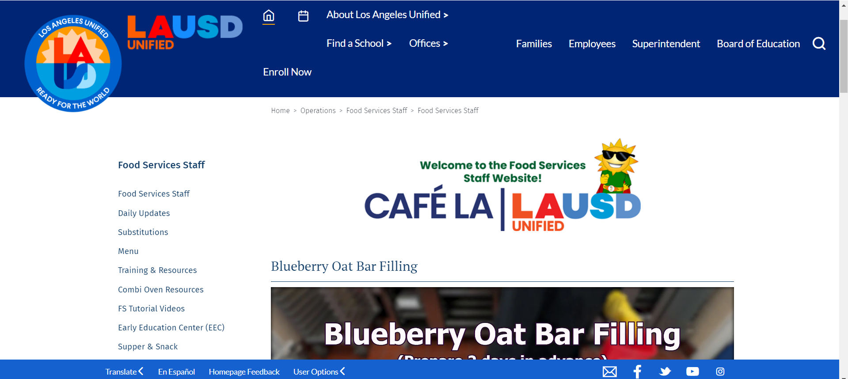
Locating the Incident Record
The Incident Record can be found on the LAUSD Food Services website:
Go to the homepage of the LAUSD FSD website.
Click on the Training and Resources link.
Notes:
TELL: Let’s compare a poor versus an effective example. A poor example: Melissa got mad and yelled at Sonia. An effective example is going through the 4 “W”s and How. When did it happen? On 08/28/24 during the 9:30am break. Where did it occur? In the faculty lounge. Who was involved? Melissa Smith and Sonia Hernandez. What happened? Melissa Smith came within two inches of Sonia Hernandez’s face, pointed her finger towards Sonia’s eye and yelled, “I’m tired of your silly ass.” How did this impact the cafeteria? Staff morale and teamwork decreased.

Slide 31
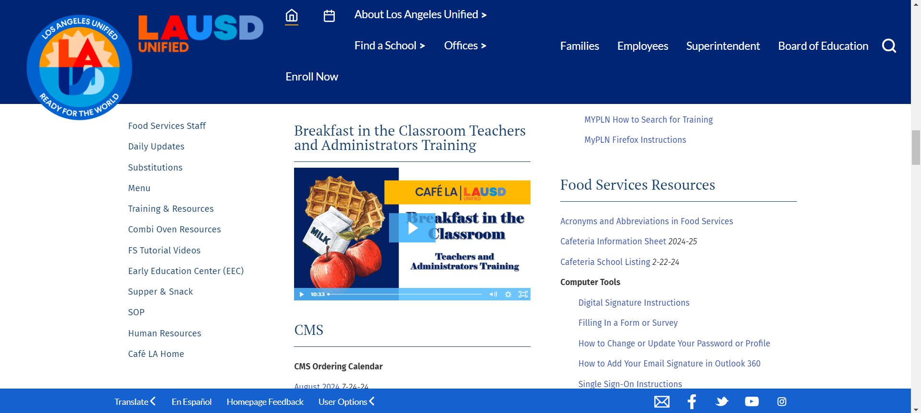
Locating the Incident Record
The Incident Record can be found on the LAUSD Food Services website:
On the Training and Resources page, go to the Food Services Resources section on the right-hand column.
Notes:
TELL: Let’s compare a poor versus an effective example. A poor example: Melissa got mad and yelled at Sonia. An effective example is going through the 4 “W”s and How. When did it happen? On 08/28/24 during the 9:30am break. Where did it occur? In the faculty lounge. Who was involved? Melissa Smith and Sonia Hernandez. What happened? Melissa Smith came within two inches of Sonia Hernandez’s face, pointed her finger towards Sonia’s eye and yelled, “I’m tired of your silly ass.” How did this impact the cafeteria? Staff morale and teamwork decreased.

Slide 32
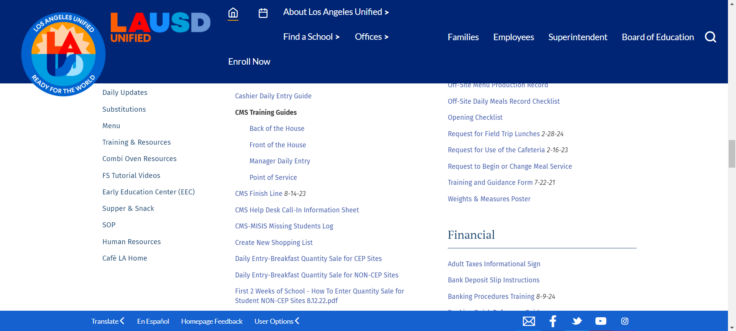
Locating the FSD Training and Guidance Form
The Incident Record can be found on the LAUSD Food Services website:
Scroll down to find the Training and Guidance Form.
Notes:
TELL: Let’s compare a poor versus an effective example. A poor example: Melissa got mad and yelled at Sonia. An effective example is going through the 4 “W”s and How. When did it happen? On 08/28/24 during the 9:30am break. Where did it occur? In the faculty lounge. Who was involved? Melissa Smith and Sonia Hernandez. What happened? Melissa Smith came within two inches of Sonia Hernandez’s face, pointed her finger towards Sonia’s eye and yelled, “I’m tired of your silly ass.” How did this impact the cafeteria? Staff morale and teamwork decreased.

Slide 33
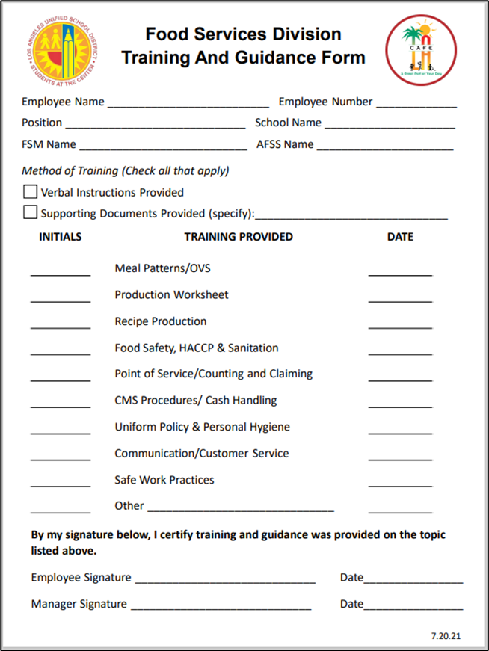
Forms
FSD Training and Guidance Form:
Notes:
TELL: Let’s read the following scenario. On January 27, 2021 @ 9:30 am the staff were taking their break in the faculty lounge. During the break, Melissa Smith came within two inches of Sonia Hernandez’s face, and pointed her finger towards Sonia’s eye and yelled, “I’m tired of your silly ass”. Note: When composing the Incident log for this situation, keep the 4 “W”s and How in mind.

Slide 34
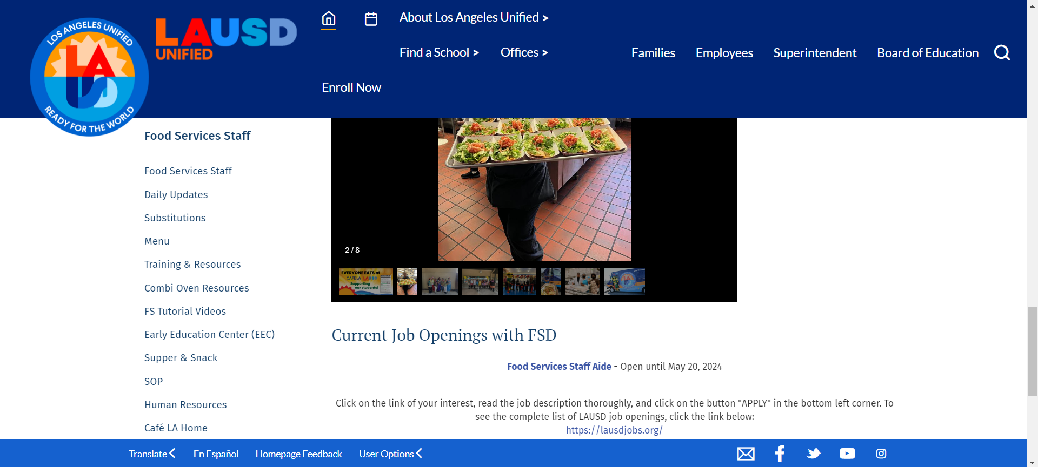
Locating the Incident Record
The Incident Record can be found on the LAUSD Food Services website:
Go to the homepage of the LAUSD FSD website.
Click on the Human Resources link.
Notes:
TELL: Let’s compare a poor versus an effective example. A poor example: Melissa got mad and yelled at Sonia. An effective example is going through the 4 “W”s and How. When did it happen? On 08/28/24 during the 9:30am break. Where did it occur? In the faculty lounge. Who was involved? Melissa Smith and Sonia Hernandez. What happened? Melissa Smith came within two inches of Sonia Hernandez’s face, pointed her finger towards Sonia’s eye and yelled, “I’m tired of your silly ass.” How did this impact the cafeteria? Staff morale and teamwork decreased.

Slide 35
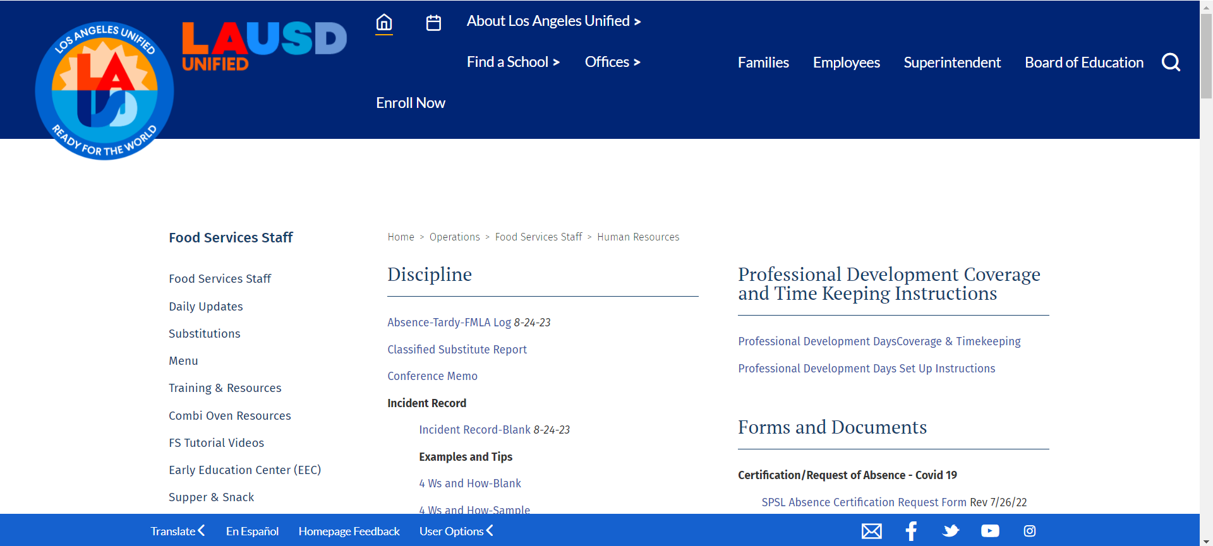
Locating the Incident Record
The Incident Record can be found on the LAUSD Food Services website:
Under the Discipline section you will click on Absence – Tardy – FMLA Log
Notes:
TELL: Let’s compare a poor versus an effective example. A poor example: Melissa got mad and yelled at Sonia. An effective example is going through the 4 “W”s and How. When did it happen? On 08/28/24 during the 9:30am break. Where did it occur? In the faculty lounge. Who was involved? Melissa Smith and Sonia Hernandez. What happened? Melissa Smith came within two inches of Sonia Hernandez’s face, pointed her finger towards Sonia’s eye and yelled, “I’m tired of your silly ass.” How did this impact the cafeteria? Staff morale and teamwork decreased.

Slide 36
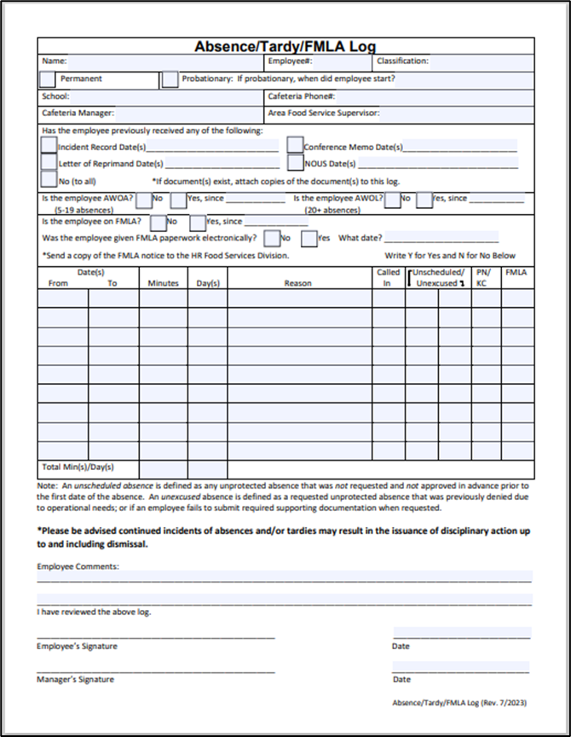
Forms
Absence/Tardy/FMLA Log:
Notes:
TELL: Let’s read the following scenario. On January 27, 2021 @ 9:30 am the staff were taking their break in the faculty lounge. During the break, Melissa Smith came within two inches of Sonia Hernandez’s face, and pointed her finger towards Sonia’s eye and yelled, “I’m tired of your silly ass”. Note: When composing the Incident log for this situation, keep the 4 “W”s and How in mind.

Slide 37
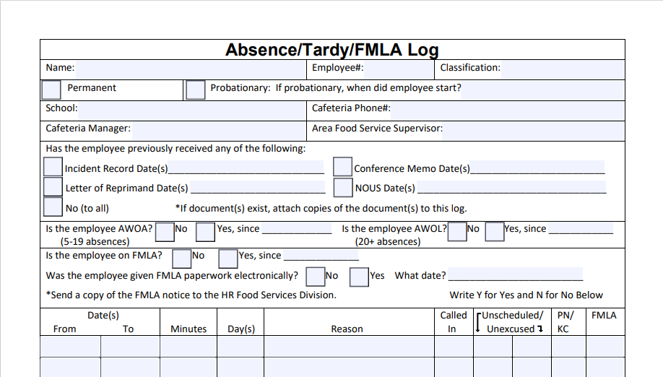
Forms
Absence – Tardy – FMLA Log:
Expanded the AWOL absence to indicate time not worked; 5-19 absences or 20+ absences

Slide 38
Forms
Absence – Tardy – FMLA Log:
Expanded the absence information to include Unscheduled Absence or Unexcused Absence along with PN/KC and FMLA

Slide 39
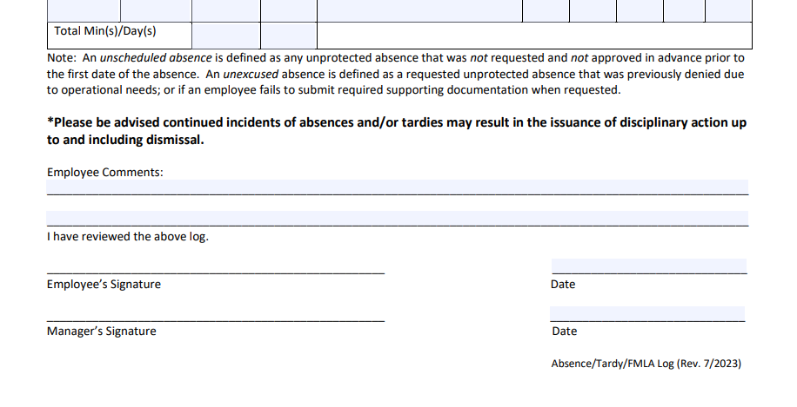
Forms
Absence – Tardy – FMLA Log:
This statement has been added to the Absence – Tardy – FMLA Log to inform employees that further absences and/or tardies may result in further disciplinary action up to and including dismissal from District Service.

Slide 40
Locating the Incident Record
The Incident Record can be found on the LAUSD Food Services website:
Under the Discipline section you will click on Incident Record Blank.
Notes:
TELL: Let’s compare a poor versus an effective example. A poor example: Melissa got mad and yelled at Sonia. An effective example is going through the 4 “W”s and How. When did it happen? On 08/28/24 during the 9:30am break. Where did it occur? In the faculty lounge. Who was involved? Melissa Smith and Sonia Hernandez. What happened? Melissa Smith came within two inches of Sonia Hernandez’s face, pointed her finger towards Sonia’s eye and yelled, “I’m tired of your silly ass.” How did this impact the cafeteria? Staff morale and teamwork decreased.

Slide 41
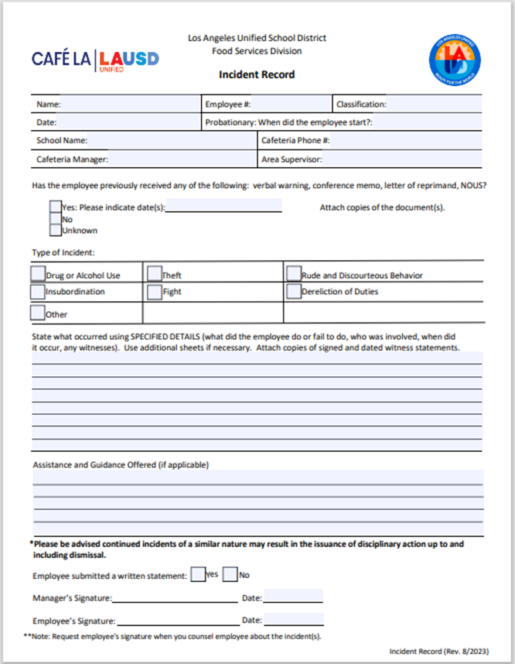
Forms
Incident Record:
Notes:
TELL: Let’s read the following scenario. On January 27, 2021 @ 9:30 am the staff were taking their break in the faculty lounge. During the break, Melissa Smith came within two inches of Sonia Hernandez’s face, and pointed her finger towards Sonia’s eye and yelled, “I’m tired of your silly ass”. Note: When composing the Incident log for this situation, keep the 4 “W”s and How in mind.

Slide 42
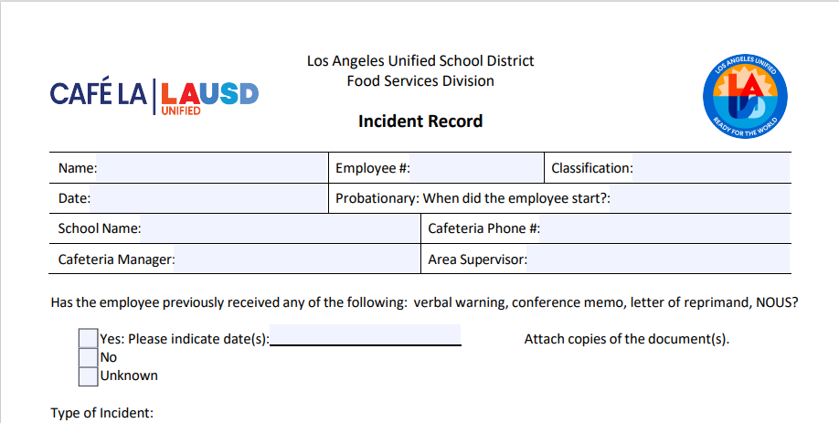
Forms
Incident Record:
Added the wording Verbal Warning to the “has the employee previously received any of the following”.

Slide 43
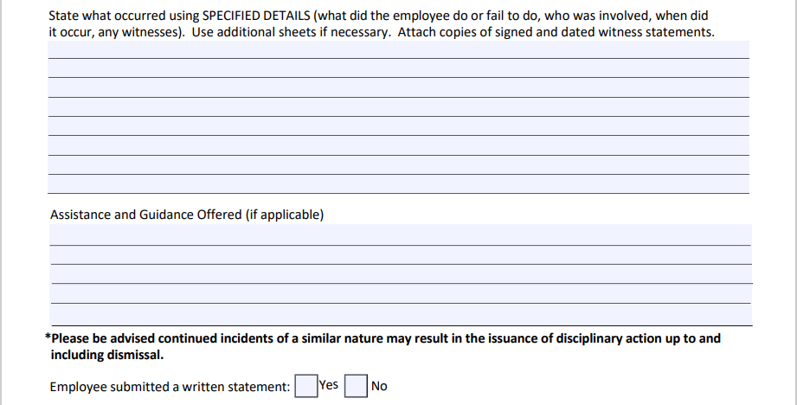
Forms
Incident Record:
Document the Incident in this section.

Slide 44
Forms
Incident Record:
Provide the Assistance and Guidance that will be delivered to the employee in this section.

Slide 45
Locating the Conference Memo
The Conference Memo can be found on the LAUSD Food Services website:
Under the Discipline section you will click on Conference Memo.

Slide 46
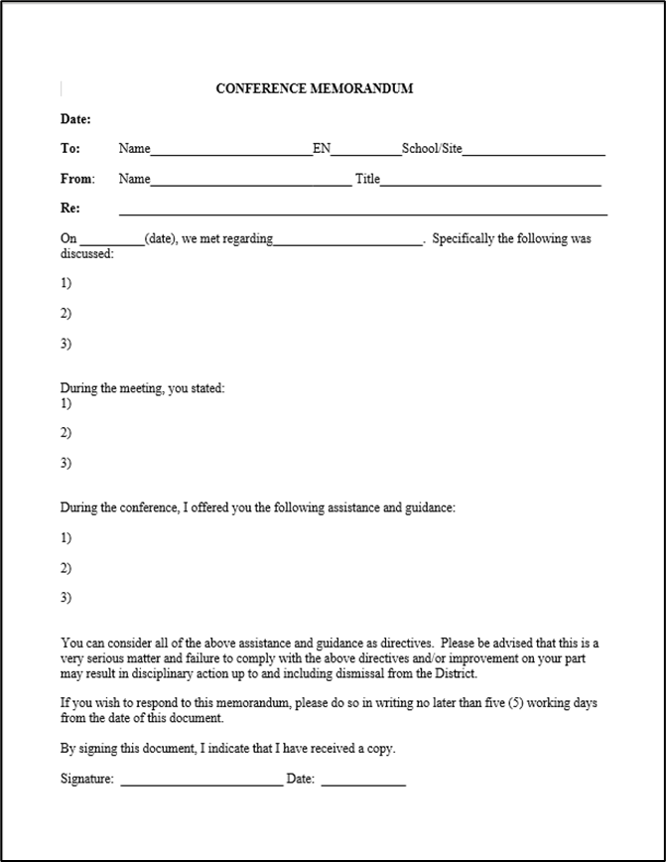
Forms
Conference Memorandum:
Notes:
TELL: Let’s read the following scenario. On January 27, 2021 @ 9:30 am the staff were taking their break in the faculty lounge. During the break, Melissa Smith came within two inches of Sonia Hernandez’s face, and pointed her finger towards Sonia’s eye and yelled, “I’m tired of your silly ass”. Note: When composing the Incident log for this situation, keep the 4 “W”s and How in mind.

Slide 47
Progressive Discipline Forms
All forms can be found on the Café LA website.
Progressive Discipline Forms:
Training and Guidance Form
Absence/Tardy/FMLA Log
Incident Record
Conference Memorandum (Letter of Reprimand)

Slide 48
Understanding Discipline Path
Let’s examine how to apply the Stairway to Progressive Discipline. Keep in mind this guide, and every situation is unique.
When an incident occurs, the FSM should discuss the appropriate behavior and what is expected of the FSW, this is a Verbal Warning.
After a Verbal Warning, provide training using the FSD Training and Guidance Form.

Slide 49
Understanding Discipline Path
Let’s examine how to apply the Stairway to Progressive Discipline. Keep in mind this guide, and every situation is unique.
If the behavior continues, note the date of the verbal warning for the previous incident on the Incident Record.
Issue an Incident Record, include supporting documentation such as previous FSD Training and Guidance Form as well as any FSD Employee Handbook policies and procedures supporting the causes.
Incident
Record
Verbal

Slide 50
Understanding Discipline Path
Let’s examine how to apply the Stairway to Progressive Discipline. Keep in mind this guide, and every situation is unique.
Conduct a meeting with the employee and issue a Conference Memorandum. Refer to the previously issued Incident Record, FSD Training and Guidance Form, and supporting documentation, as well as any FSD Employee Handbook policies and procedures supporting the cause.
Incident
Record
Conference
Memorandum
Verbal

Slide 51
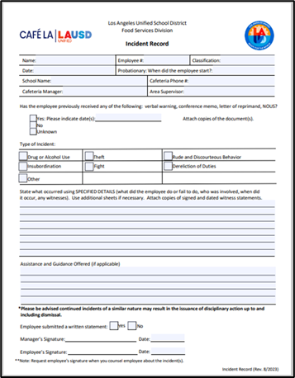
Understanding Discipline Path
Forms needed for Progressive Discipline.
Incident
Record
Conference
Memorandum
Verbal

Slide 52
Understanding Discipline Path
Let’s examine how to apply the Stairway to Progressive Discipline. Keep in mind this guide, and every situation is unique.
The AFSS will meet with the employee to issue a Letter of Reprimand. Refer to the previously issued Conference Memorandum, Incident Record, FSD Training and Guidance Form, and supporting documentation, as well as any FSD Employee Handbook policies and procedures supporting the causes.
Incident
Record
Conference
Memorandum
Verbal

Slide 53
Understanding Discipline Path
Let’s examine how to apply the Stairway to Progressive Discipline. Keep in mind this guide, and every situation is unique.
If the behavior continues persists, the AFSS will confer with the HR Representative and issue the employee a Notice of Unsatisfactory Service.
Discipline:
NOUS with Suspension without Pay
Demotion
Dismissal from District Service

Slide 54
Progressive Discipline
Progressive Discipline is a step-by-step process
to correct the employee’s behavior.
FSM/AFSS: Verbal
FSM/AFSS: Incident Record
FSM/AFSS: Conference Memorandum
FSM/AFSS/HR: Letter of Reprimand
HR: NOUS and No Action
HR: NOUS and Disciplinary Action

Slide 55
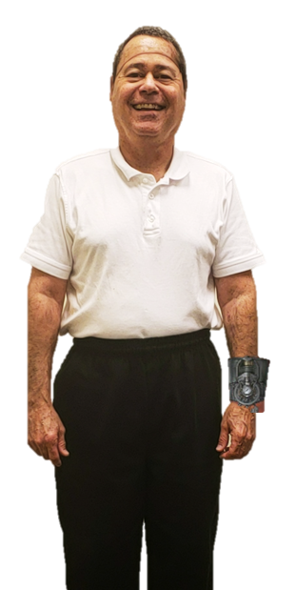
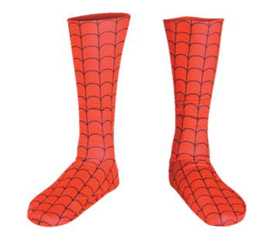
Scenario Incident #1
August 28, 2024 Probationary FSW Peter Parker (employee# 1234567), arrived at the Daily Bugle Elementary cafeteria for work. Mr. Parker started on May 12, 2024.
Upon arrival, he had on his Spider-Man boots and a web sling device on his left wrist. The FSM, J. Jonah Jameson spoke with Mr. Parker about the correct uniform attire for LAUSD FSW.
Mr. Jameson also contacted his AFSS, Stanley M. Lieber regarding the incident.

Slide 56
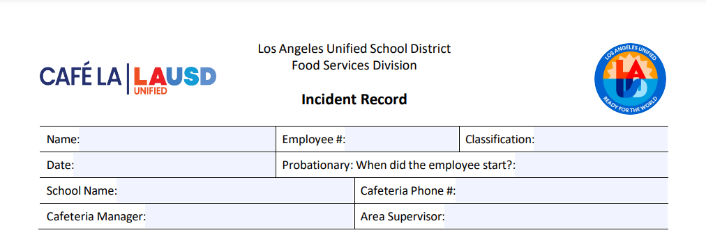
Incident Record Sample for
Peter Parker
Peter Parker
1234567
FSW
August 28, 2024
May 12, 2024
Daily Bugle Elementary
(213)867-5309
J. Jonah Jameson
Stanley M. Lieber
Notes:
TELL: This is a blank Incident Log with spaces that allow you to type information into the document directly on the food services website. Typing is not mandatory. A handwritten Incident Log is acceptable for as long as it’s legible.

Slide 57
Incident Record Sample for
Peter Parker
X
If the employee has received previous training and guidance, complete the applicable answer.
Notes:
TELL: This is a blank Incident Log with spaces that allow you to type information into the document directly on the food services website. Typing is not mandatory. A handwritten Incident Log is acceptable for as long as it’s legible.

Slide 58
Incident Record Sample for
Peter Parker
X
Select the applicable incident with an X or a √ mark .
Notes:
TELL: This is a blank Incident Log with spaces that allow you to type information into the document directly on the food services website. Typing is not mandatory. A handwritten Incident Log is acceptable for as long as it’s legible.

Slide 59
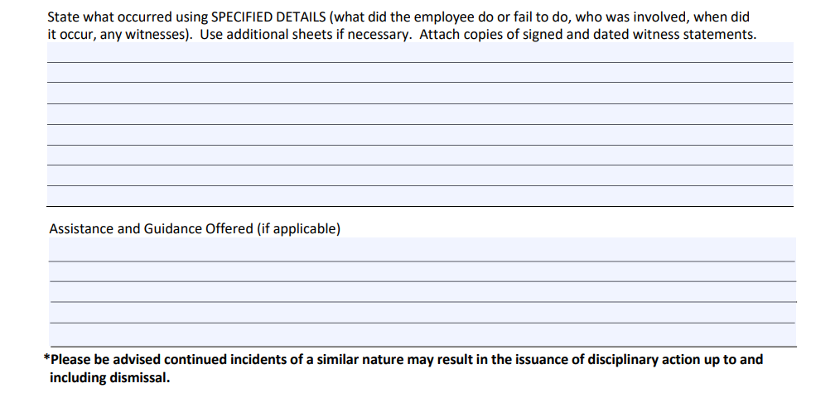
Incident Record Sample for
Peter Parker
Peter Parker Was not in compliance with LAUSD FSD uniform attire. FSW are required to wear non-slip resistant shoes and jewelry not to be worn in kitchen.
Please refer to LAUSD FSD Employee Handbook, Section Vlll. School Based Dress Code Policy, Safety Apparel, and Personal protection Equipment (page 61-64).
Notes:
TELL: This is a blank Incident Log with spaces that allow you to type information into the document directly on the food services website. Typing is not mandatory. A handwritten Incident Log is acceptable for as long as it’s legible.

Slide 60
Sample Signatures on
Incident Log
X
J. Jonah Jameson
August 28, 2024
Peter Parker
August 28, 2024
Notes:
TELL: This is a blank Incident Log with spaces that allow you to type information into the document directly on the food services website. Typing is not mandatory. A handwritten Incident Log is acceptable for as long as it’s legible.

Slide 61
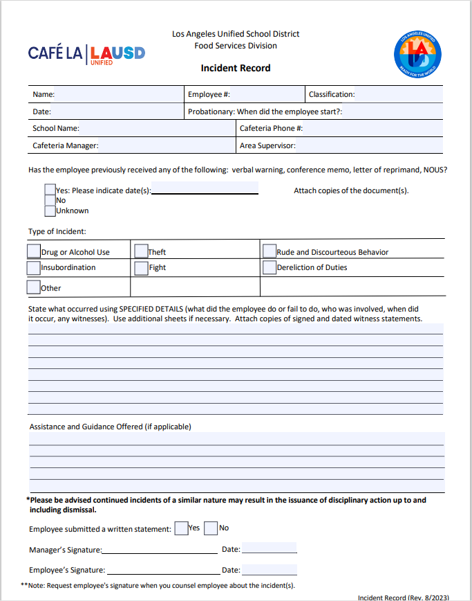
Group Incident Record
KEEP
CALM
AND
NOW
YOUR
TURN
Notes:
TELL: This is a blank Incident Log with spaces that allow you to type information into the document directly on the food services website. Typing is not mandatory. A handwritten Incident Log is acceptable for as long as it’s legible.

Slide 62
Sample Incident #2
On August 28, 2024, Food Service Worker, Jane Smith, Employee Number 1234567, was preparing the chef salad for lunch service next to POS #3. Co-Worker FSW Martin Short asked Jane Smith if she had already counted the carrot packets. Ms. Smith responded in a loud and angry voice to Mr. Short, “I already told you I had awhile ago. DO I have to repeat myself over and over to you?”
Willy G. Wonka, who was standing a foot away from Ms. Smith heard Ms. Smith call Mr. Short “stupid” when Mr. Short walked away from Ms. Smith.

Slide 63
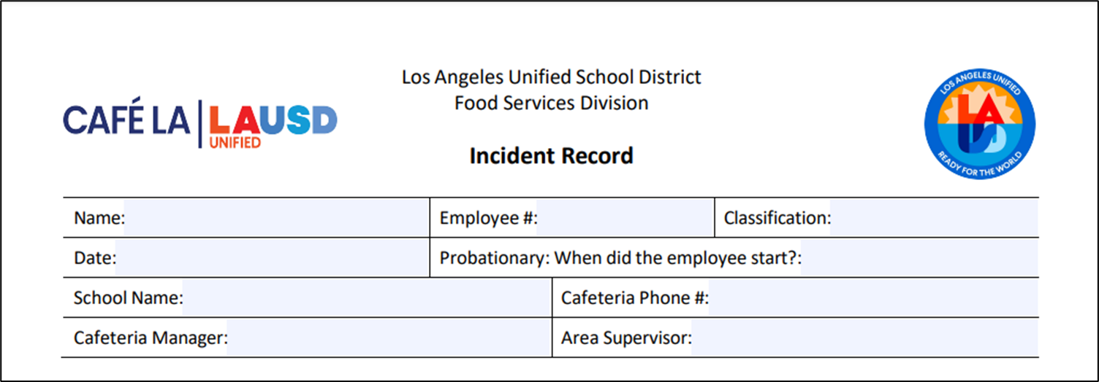
Completing Incident Record
As A Group
Jane Smith
1234567
FSW
August 28, 2024
N/A or Leave Blank
Insert your school’s name
Insert phone number
Insert your name
Insert your AFSS name
Notes:
TELL: This is a blank Incident Log with spaces that allow you to type information into the document directly on the food services website. Typing is not mandatory. A handwritten Incident Log is acceptable for as long as it’s legible.

Slide 64
Group Choosing
Incident Type
x
August 28, 2024
x
Notes:
TELL: This is a blank Incident Log with spaces that allow you to type information into the document directly on the food services website. Typing is not mandatory. A handwritten Incident Log is acceptable for as long as it’s legible.

Slide 65
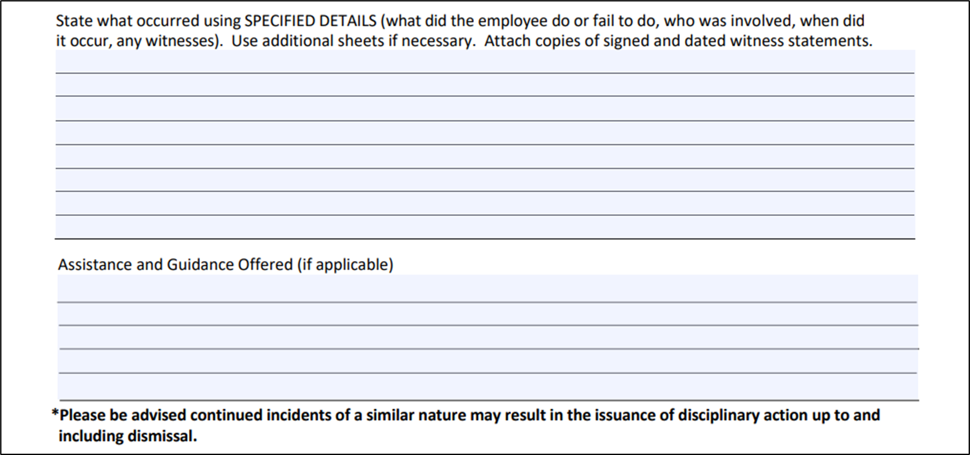
Writing Specified Details
with the Group
Jane Smith was preparing the chefs salads for lunch service by POS #3. Co-Worker Martin Short asked Jane Smith if she had counted the carrot packets. FSW Smith responded loudly and in an angry voice “I already told you I had awhile ago. Do I have to repeat myself?”
Please refer to LAUSD FSD Employee Handbook, Section AX. Workplace Violence, Bullying, and Threats (page 35-36).
Notes:
TELL: This is a blank Incident Log with spaces that allow you to type information into the document directly on the food services website. Typing is not mandatory. A handwritten Incident Log is acceptable for as long as it’s legible.

Slide 66
Signatures on
Incident Log
X
Insert Your Name
Today’s Date
Employee Refused to Sign
Today’s Date
What do you do when the employee refuses to sign the Incident Record?
Notes:
TELL: This is a blank Incident Log with spaces that allow you to type information into the document directly on the food services website. Typing is not mandatory. A handwritten Incident Log is acceptable for as long as it’s legible.

Slide 67
Signatures on
Incident Log
X
Mariah Carey,
Mariah Carey, Principal of ABC Elementary School witness Employee refusal to sign.
Insert Your Name
Today’s Date
Employee Refused to Sign
Today’s Date
Instruct FSW Willy Wonka to complete a Witness Statement Form (located on the FSD website) and attach to the Incident Record.
Notes:
TELL: This is a blank Incident Log with spaces that allow you to type information into the document directly on the food services website. Typing is not mandatory. A handwritten Incident Log is acceptable for as long as it’s legible.

Slide 68
What is the FSD HR Flow Chart?
The Flow Chart is a tool that was created to assist the FSM and AFSS in recommending the disciplinary action and documentation to be used for any policy and/or procedure infraction incurred by the employee.
Note: The disciplinary actions listed in the flow chart are suggested and not absolute.
If in doubt, contact your AFSS or HR Rep.

Slide 69
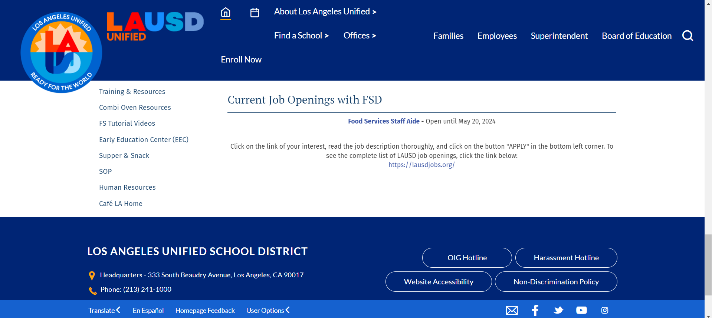
Locating the HR Flow Chart?
If in doubt, contact your AFSS or HR Rep.
Scroll down to Human Resources link on the FSD website.

Slide 70
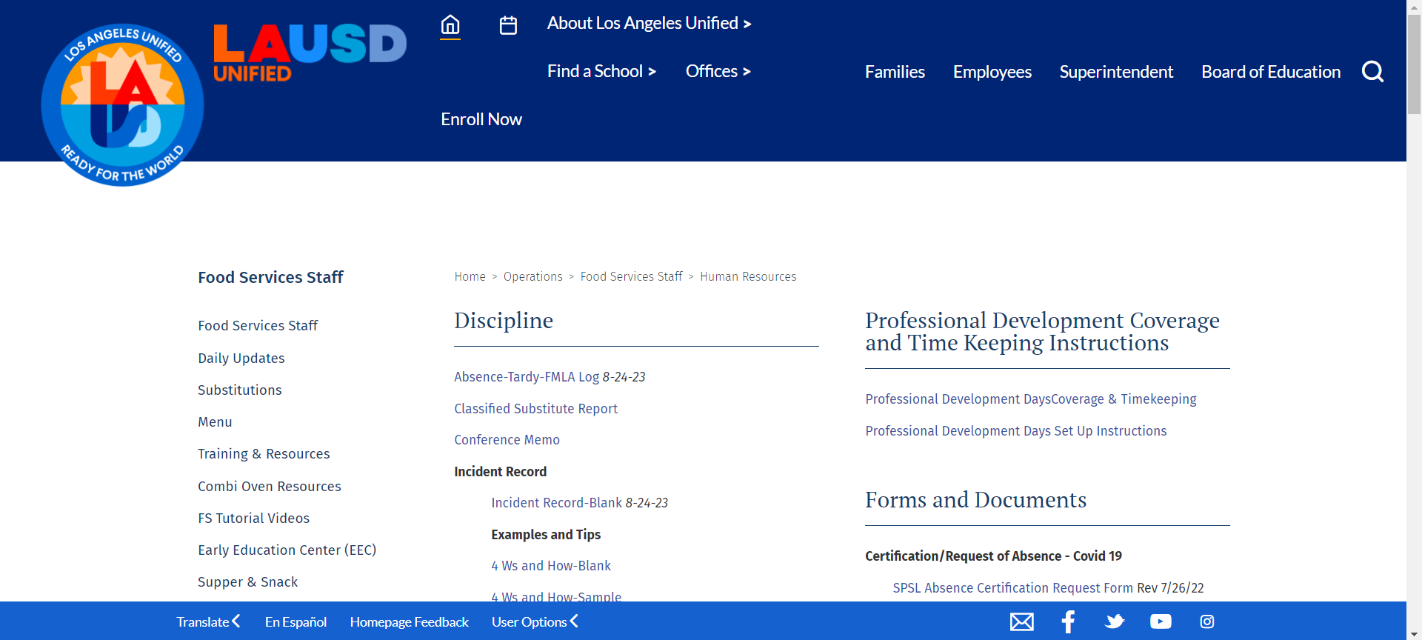
Locating the HR Flow Chart?
Go to Discipline section on the HR page.

Slide 71
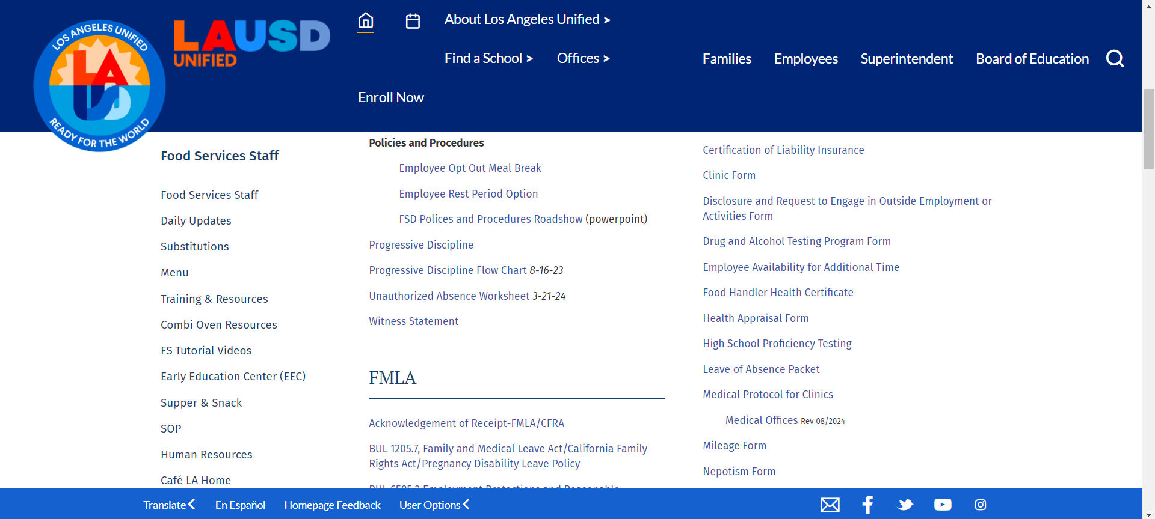
Locating the HR Flow Chart?
Under the Policies and Procedures section is the Progressive Discipline Flow Chart link consisting of 6 pages.

Slide 72
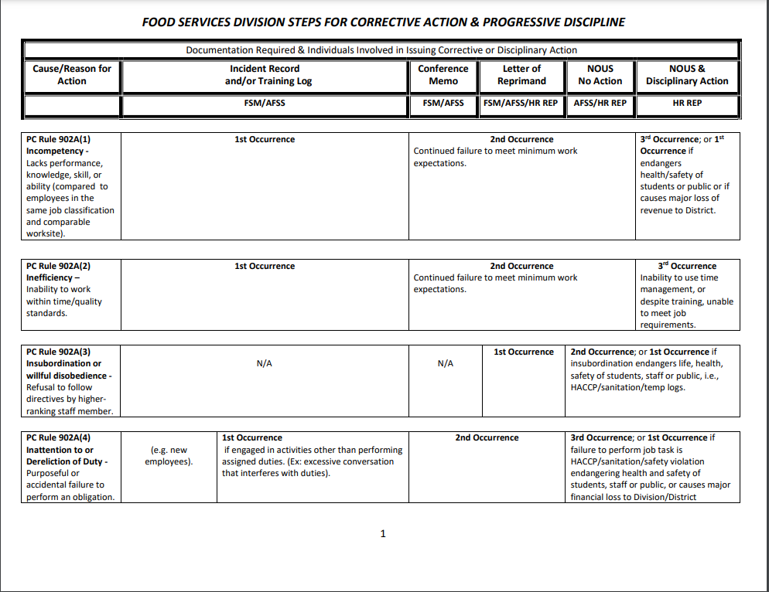
Progressive Discipline
Flow Chart

Slide 73
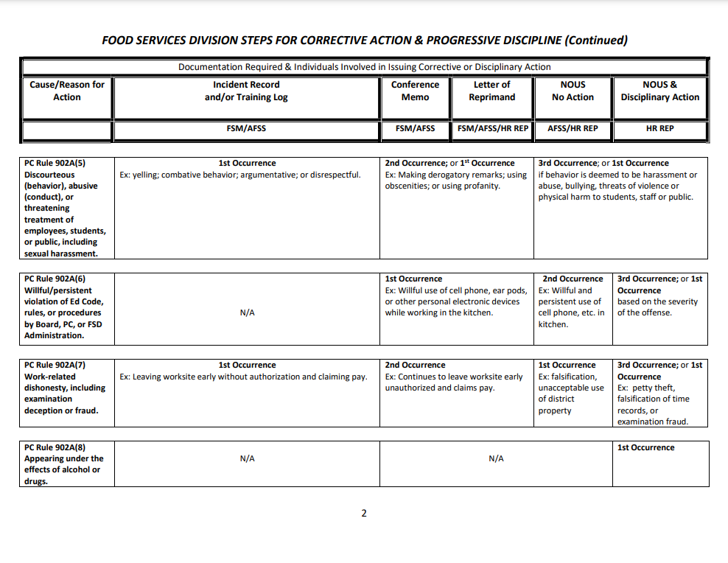
Progressive Discipline
Flow Chart

Slide 74
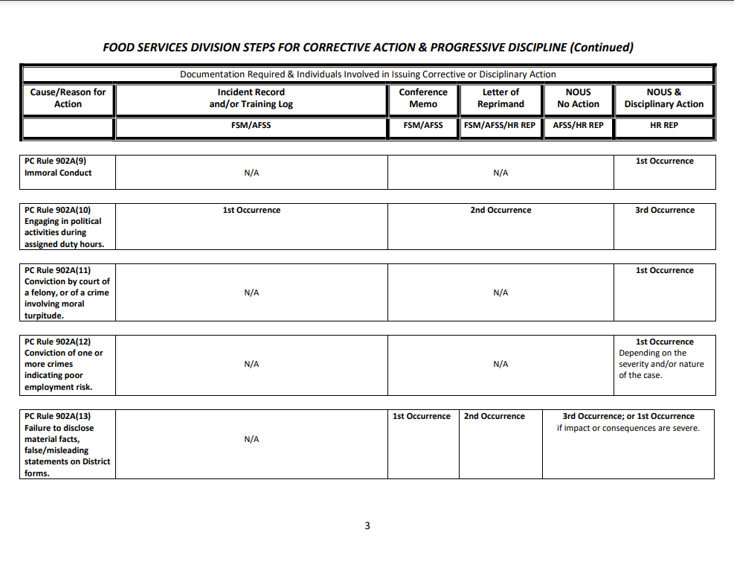
Progressive Discipline
Flow Chart

Slide 75
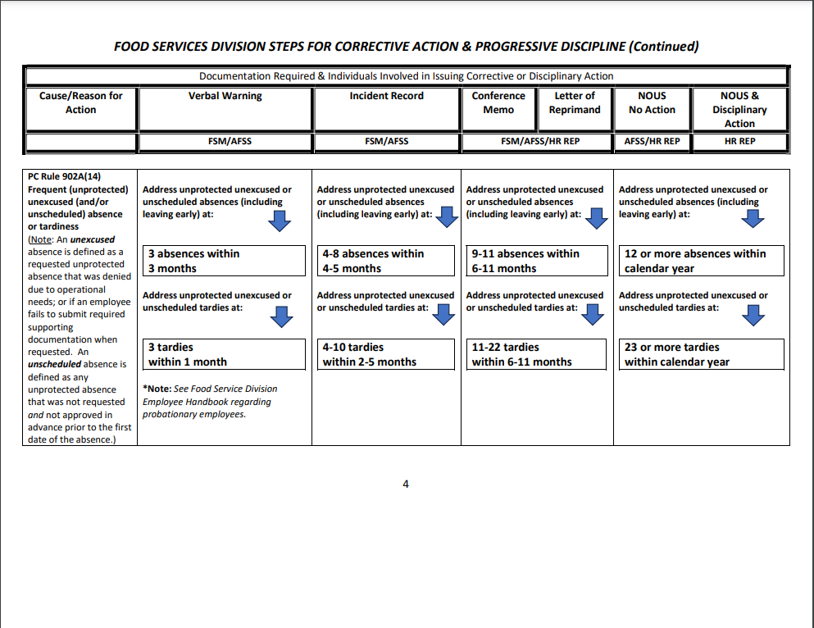
Progressive Discipline
Flow Chart

Slide 76
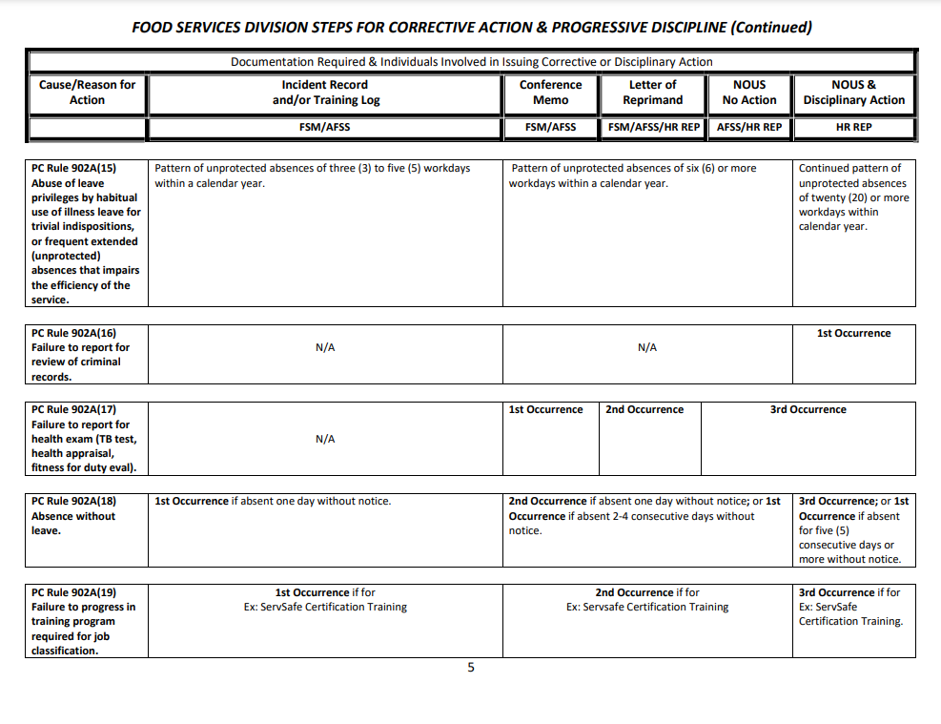
Progressive Discipline
Flow Chart

Slide 77
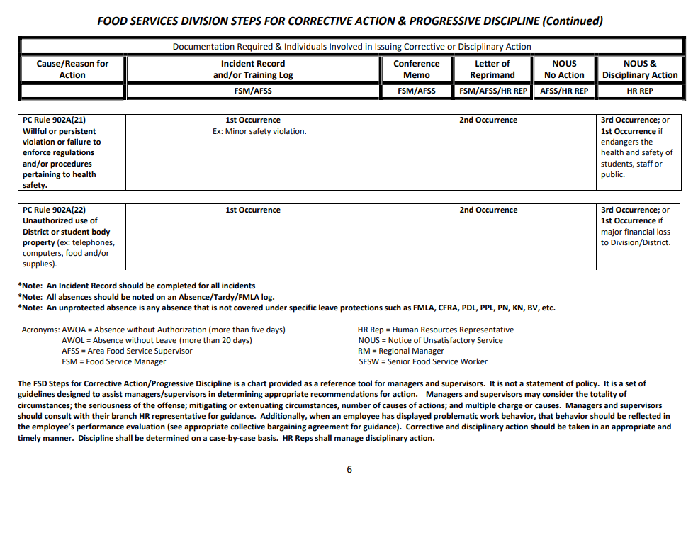
Progressive Discipline
Flow Chart

Slide 78
Progressive Discipline
Flow Chart
The Headers of the Progressive Flow Chart are:
Cause/Reason for Action (Responsible Party)
Incident Record and/or Training Log (FSM/AFSS)
Conference Memo (FSM/AFSS)
Letter of Reprimand (FSM/AFSS/HR Rep)
NOUS No Action (AFSS/HR Rep)
NOUS & Disciplinary Action (HR Rep)

Slide 79
Progressive Discipline
Flow Chart
The Flow Chart is comprised of the causes or reasons for discipline from the Personnel Commission Rules 902A (1-23). We are going to explore the regularly violated causes seen in Food Services.

Slide 80
Application of the Flow Chart
What is Insubordination?
PC Rule 902A (3) defines Insubordination or Willful Disobedience as refusal to follow directives by higher ranking staff member.
Scenario: The FSM tells a FSW that they need to do the dishes. The FSW responds “I am not doing that because I did it yesterday!”
What action would you perform and who would be responsible for this action?

Slide 81
Application of the Flow Chart
What is Dereliction of Duty?
PC Rule 902A (4) defines Inattention To or Dereliction of Duty is the purposeful or accidental failure to perform an obligation.
Scenario: The FSM tells a SFSW to have the scramble line ready 15-minutes before lunch service (11:10am). At 10:55am, the FSM comes to review the scramble area; sees the SFSW laughing and chatting with the Plant Manager and the scramble line is not ready.
What action would you perform and who would be responsible for this action?

Slide 82
Application of the Flow Chart
What is Rude and Discourteous Behavior?
PC Rule 902A (5) is Discourteous (behavior), Abusive (conduct), or Threatening Treatment of Employees, Student or Public, including Sexual Harassment.
Scenario: The FSM is told that 2 workers of the 4-person team are out sick. The FSW responds “That’s bull$h*%! They knew it was Chicken Teriyaki day! They always call off.”
What action would you perform and who would be responsible for this action?

Slide 83
Application of the Flow Chart
What is Work-Related Dishonesty?
PC Rule 902A (7) is Work-Related Dishonesty including examination, deception, or fraud.
Scenario: The FSM goes to turn in the timesheets to the SAA. During the review of the weekly timesheets, discovers one of the FSW who was 15-minutes late failed to document on their timesheet and put their regular time worked.
What action would you perform and who would be responsible for this action?

Slide 84
Application of the Flow Chart
What is Frequent Absence or Tardiness?
PC Rule 902A (14) is Frequent (unprotected) unexcused and/or unscheduled absence or tardiness.
Scenario: The FSW has called off for the day. They have four other non-consecutive unexcused absences in the last two months.
What action would you perform and who would be responsible for this action?

Slide 85
Application of the Flow Chart

Slide 86
Application of the Flow Chart
What is Abuse of Leave Privileges?
PC Rule 902A (15) refers to Abuse of Leave Privileges by habitual use of illness leave for trivial indispositions, or frequent extended (unprotected) absences that impairs the efficiency of the service.
Scenario: The worker has called in sick for the last six Fridays. This Friday, they called in again claiming to be sick.
What action would you perform and who would be responsible for this action?

Slide 87
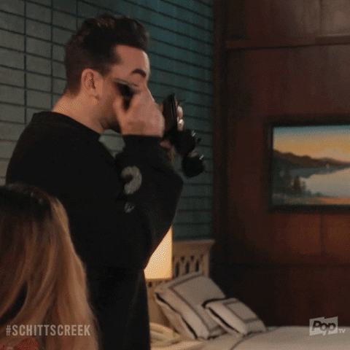
Questions about Progressive Discipline?

Slide 88
Thank You
for participating in this training and
for all that you do.
Notes:
TELL: Ensure that your staff is equipped with the proper tools and resources to do their job successfully. Continuous training is key. Provide frequent feedback and coaching. Encourage professional development by attending classes offered by Organizational Excellence and/or MyPLN.

